Slide 1
DSA project Semester 2 2019
Nhu Dinh Nam – ITITIU16114
Do Thai Anh Huy – ITITIU
Le Gia Vy – ITITIU
Tang Minh Khoi – ITITIU

Slide 2



Introduction to 2048 game

Slide 3
Feature, structure and design.
Feature
in one file HTML only.
Move
Disappear
Increment itself
Change its color (each point has special color for easy to realize).
Structure
Javascript is put in <script> tag in HTML.
Design

Slide 4

List of contribution
https://github.com/HCMIU-CSE-DSA2019/2048
Github link.

Slide 5
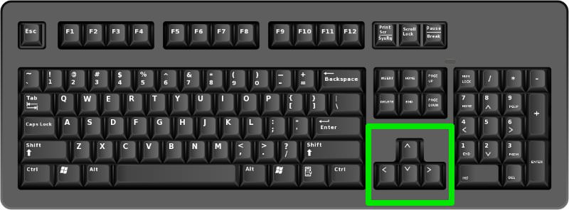
User guide
Enter your name before playing to make a record.
Using up, down, left, right array key to play game.
The user has to slide numbered tiles on a 4x4 grid in order to merge them into a tile of a higher value.
Merge tiles up to 2048 to win

Slide 6
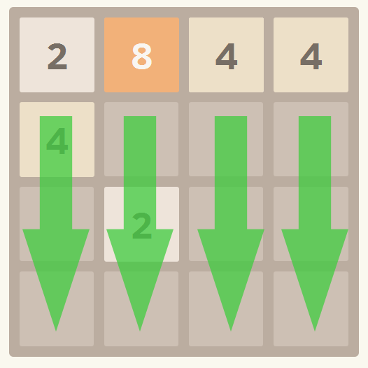
Tile Simple Move
The main component is the game grid, which consists of 4 rows and 4 columns.
Notes:
Whenever a user makes a swipe - all the tiles of the grid move in the direction of the swipe. If two tiles with an equal number align next two each other after the movement, they merge

Slide 7
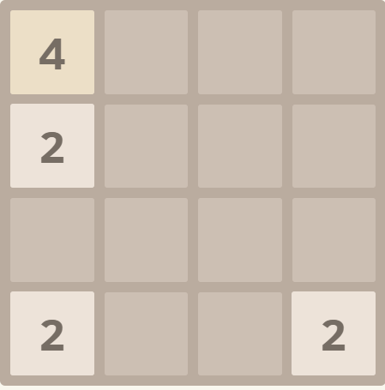
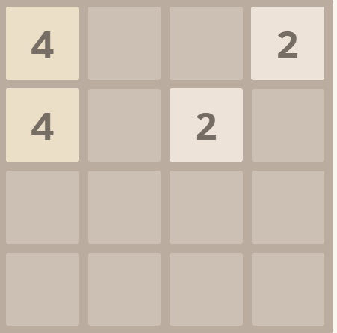
The Simple Move
Create new tile with 2 or 4
2 merge 2 is 4
Notes:
2 merge with 2 ,

Slide 8
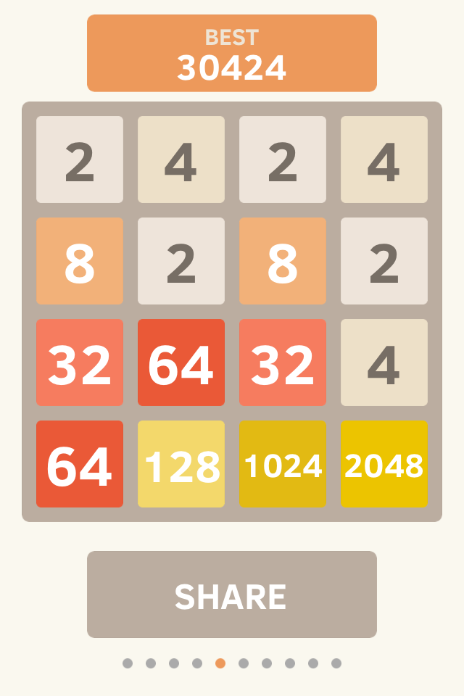
Win
Win if you can make a 2048 tile

Slide 9
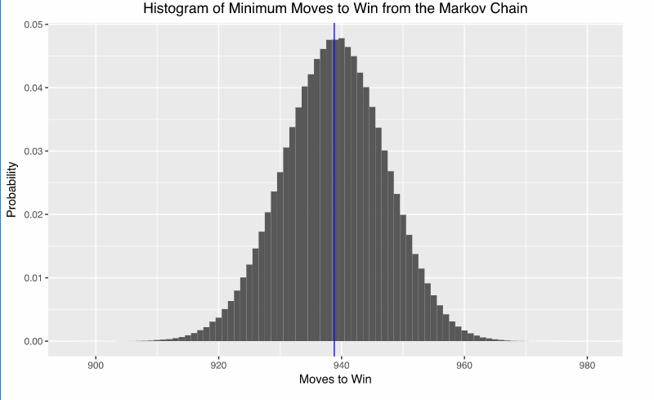
Minimum steps to win 2048 game
Using Makov Chain to find down the minimum steps to win the game.

Slide 10
Design

Slide 11
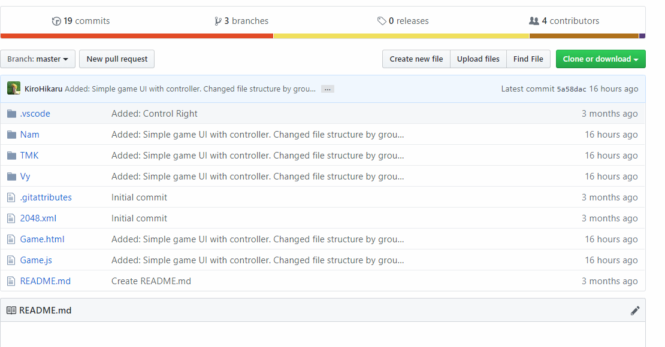
Install in other computer.
We share it on github.
Another can clone it through link or download zip file.

Slide 12
Thank you for listening

